Slide 1



ICT ACADEMY TRAINING CERTIFICATE COURSE IN
DATA ANALYTICS
PROJECT
ON
US CARS SALES ANALYSIS
TEAM MEMBERS
R. DARSHAN
S. HARI HARAN
T. VIGNESHWARAN
G. KIRUTHIKA
A. SWETHA
B. PRAVEEN

Slide 2
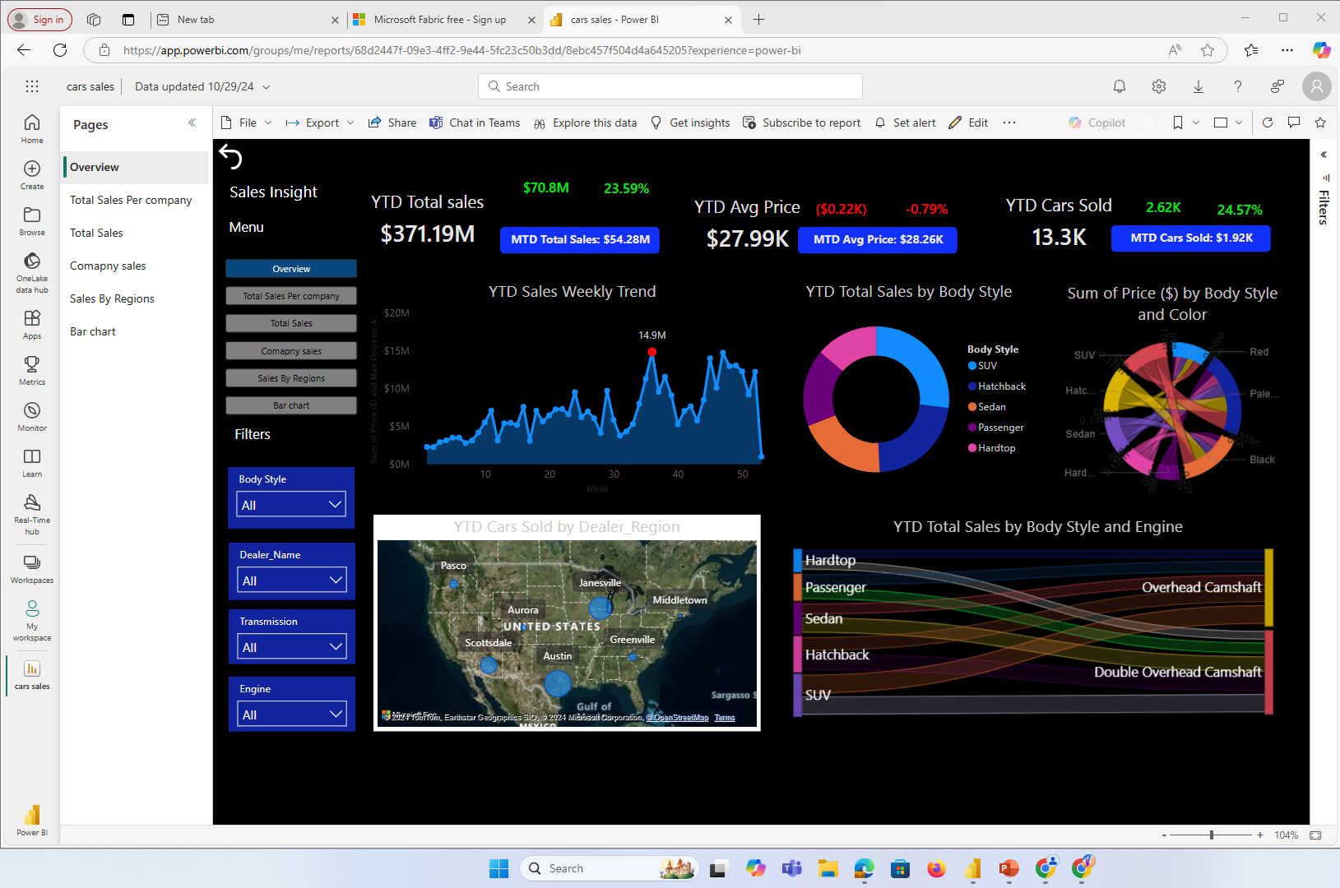

Slide 3
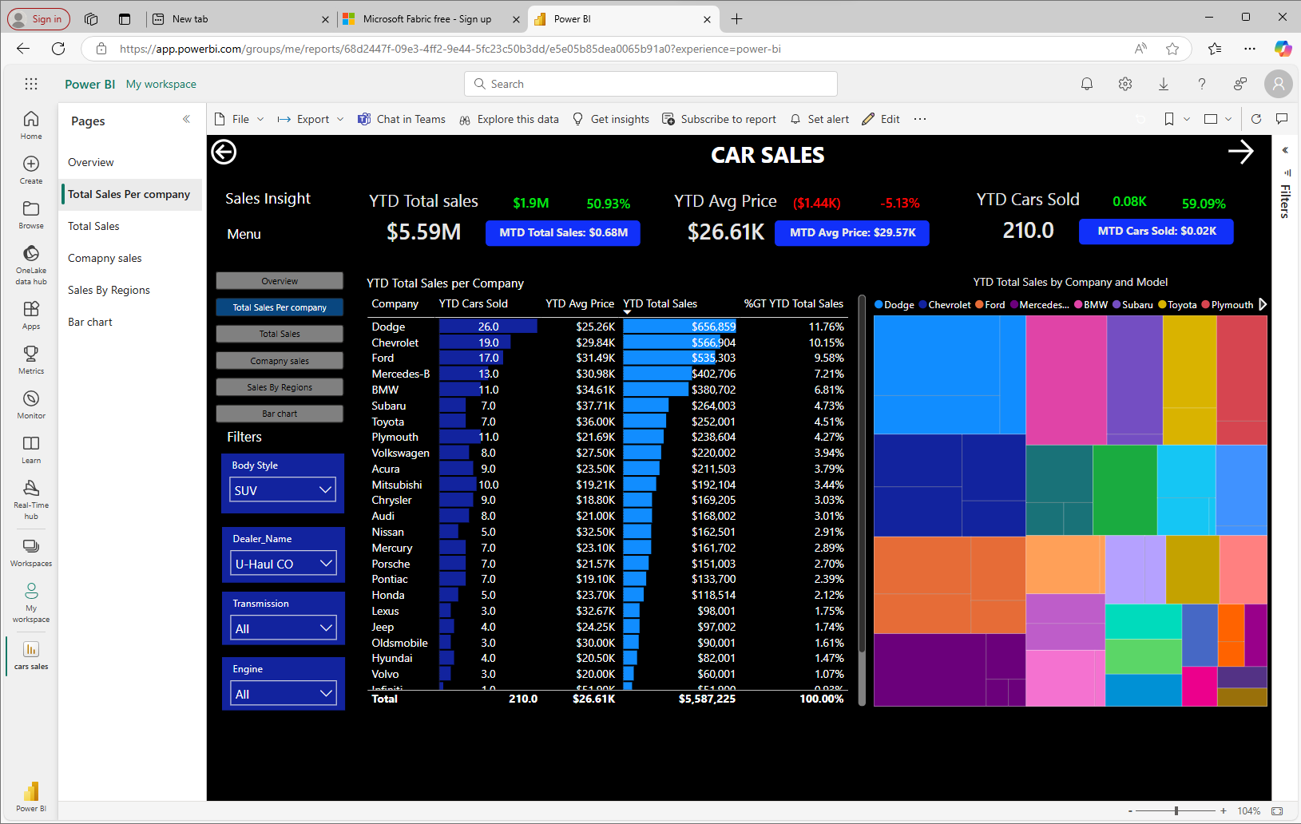

Slide 4
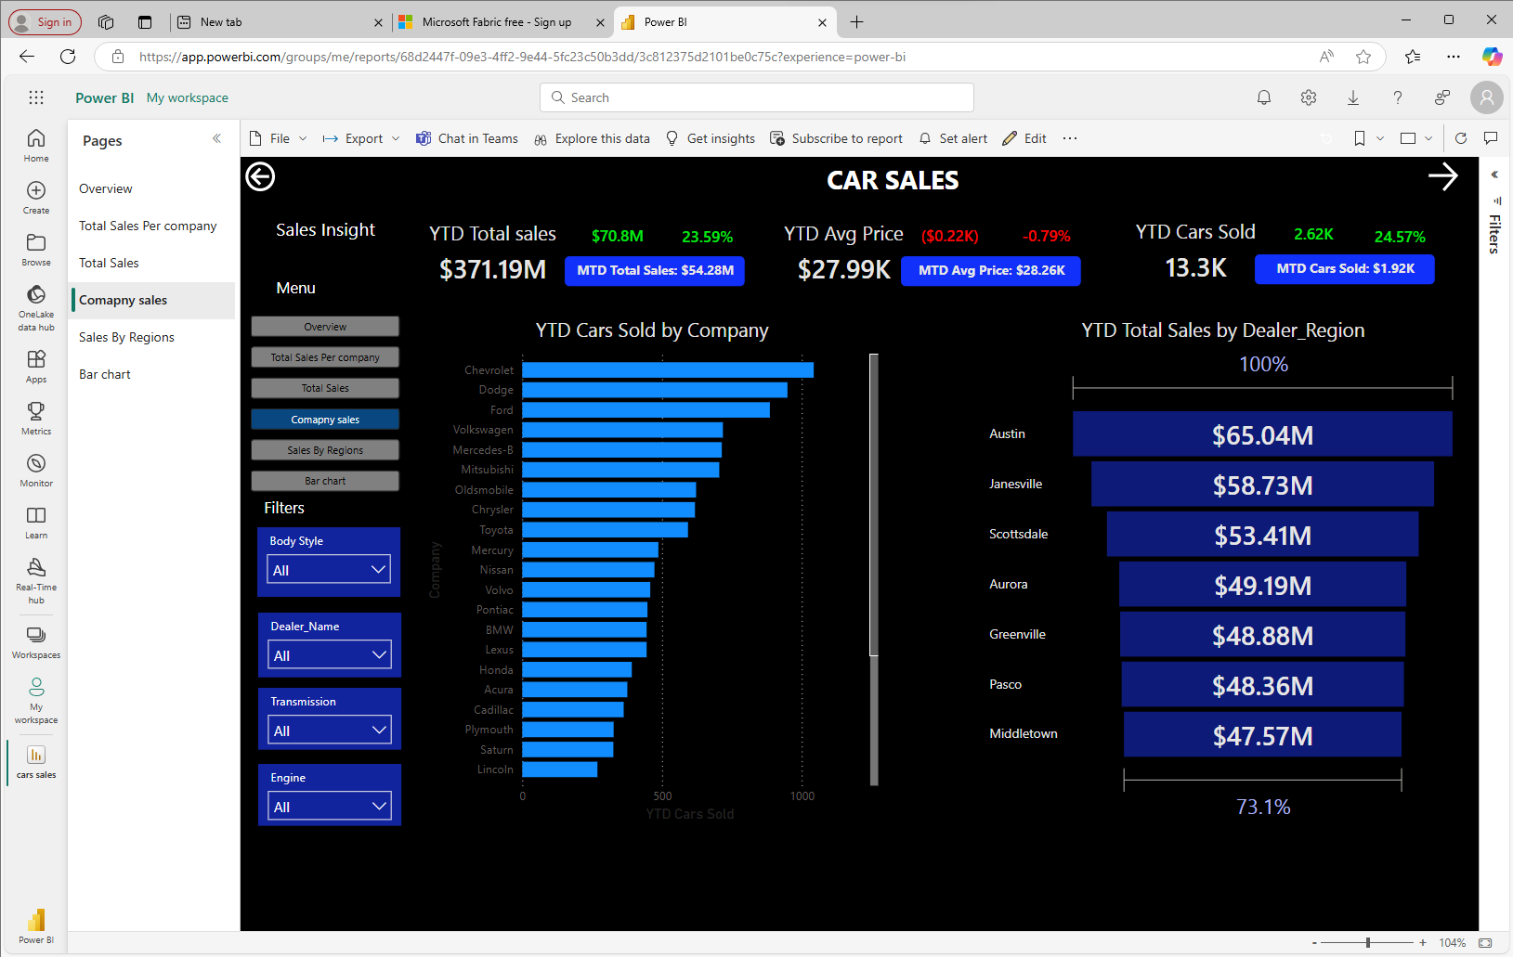

Slide 5
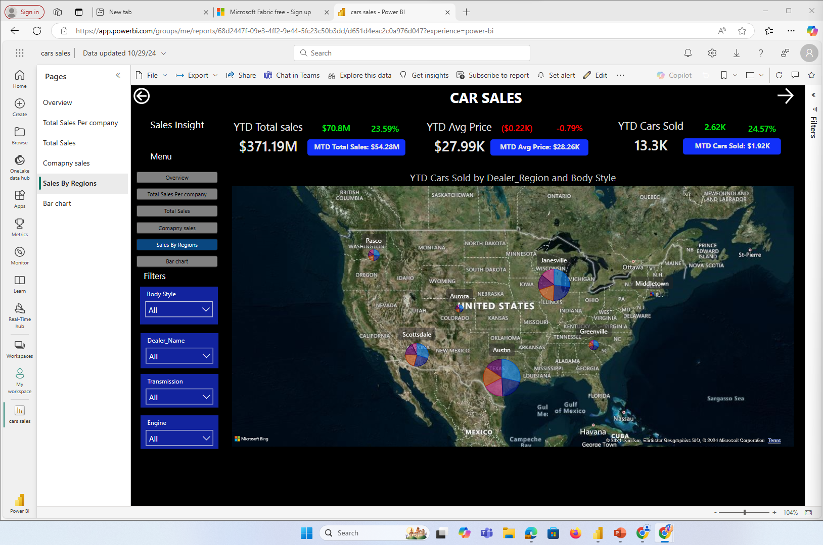

Slide 6
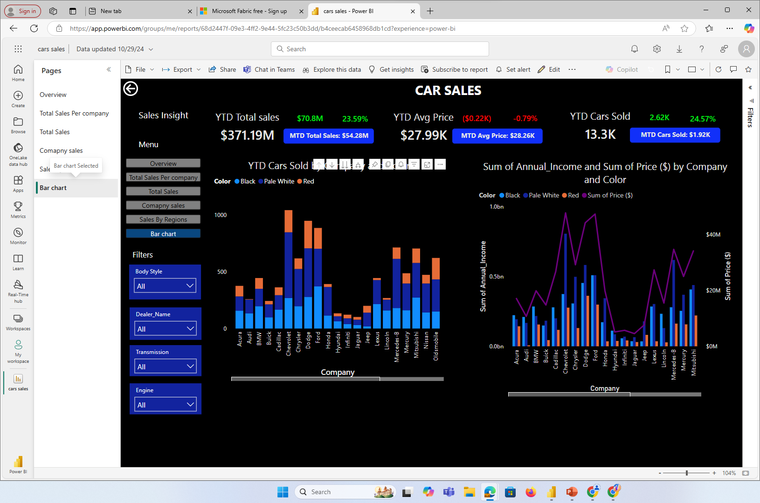

Slide 7
